Slide 1

Welcome to the Riot API Bootcamp!
Know more, win more.

Slide 2








What is the purpose of this course?
Learning to use the Riot API is a bit of a struggle. There's very few resources out there and they're not very structured.
“The Riot API Bootcamp Course is designed to take you from no knowledge up to building your own app.”

Slide 3
Riot API Bootcamp syllabus
Basics (Python, GitHub, Notepad++)
Resources to get started
Setting up an environment
Downloading GitHub repos
JSON explanation & Notepad++ example
Project: read csv file, convert to data frame, create graphs
Riot API introduction
What is an API?
Getting access & Registering your App
What end points are there/what data is available?
Explanation of puuid/account name
Project: make an API call on the website & download the data
Automating API interactions
Introduction to libraries (Cassiopeia, Riot Watcher)
Getting help (documentation, Discord)
Project: automate an API call using a library
Single Endpoint Data
Use case explanation (e.g., in-depth match analysis, leaderboards)
Code example- getting challenger leaderboard
Project: request last 25 games for an account and determine the most common champion(s)
Large Scale Data Collection
Use case explanation (e.g., match history of top 50 players)
Setting up a process pipeline
Comparing 1 file approach vs. functions across files approach
Project: determine number of roles (TOP, MID, etc) on the challenger ladder using the last 5 games
5 Modules covering core topics Project at the end of each

Slide 4
What games does the RIOT api support?
League of Legends
Riot API was originally designed for LoL
Variety of endpoints
Supports tournament game creation
Legends of Runeterra
Gets card info, game state
Mostly interacts with client
Teamfight Tactics
Similar end points to LoL
Specific data is limited (item names, but not effects)
Valorant
Must have a working app first
Requires approval from Riot
4

Slide 5
What games does the RIOT api support?
5

Slide 6
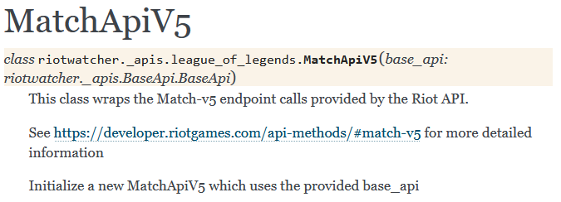
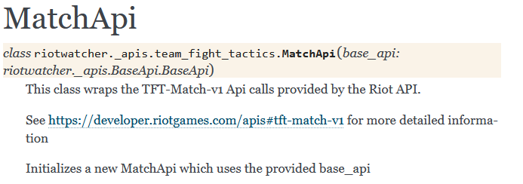
Syntax is similar regardless of game
The Python wrapper used in this course (Riot Watcher) standardizes Riot API calls regardless of the game
LoL: Getting a match by MatchID
league_of_legends.match.by_id(region= str, match_id= str)
TFT: Getting a match by MatchID
team_fight_tactics.match.by_id(region: str, match_id: str)
Examples and projects will be for League of Legends
Most data available
Riot API was originally designed for LoL
Fundamental concepts are the same across all Riot API games
(League of Legends)
(Teamfight Tactics)

Slide 7


Questions?
Contact me
It is my hope that this course is easy to understand and follow
Have a question or want additional details? Just reach out!
If you want to know more about my work (LoL Genius) or have questions about something you’re building, LMK!

